Slide 1

Housing Market Trends and Affordability in the U.S.
Milestone 3 Presentation
Armin Heldovac | DSC 680 | 10/5/2025

Slide 2
Introduction & Purpose
Housing affordability has become one of the biggest issues in the U.S.
Rising rents and low incomes create a financial burden for families.
Why this matters: it affects families, workforce, and broader economy.

Slide 3
Background & Context
The housing market has been shaped by cycles of boom and bust.
2008 housing crash caused a decline in housing and the COVID-19 pandemic triggered another housing surge.
Coastal states face limited supply and high demand which drives up prices.
Affordability impacts policy, development, and financial institutions.

Slide 4
Methods
Step 1: Data cleaning (currency conversion, missing values handling).
Step 2: Calculation of affordability: rent-to-income ratio (%).
Step 3: Descriptive statistics and rankings for states.
Step 4: Visualization: bar charts, scatter plots, histograms.
Step 5: Regression modeling: income vs. rent correlation.

Slide 5
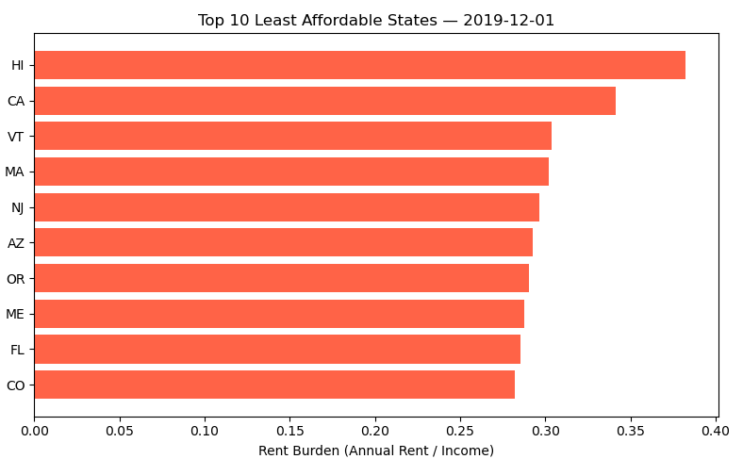
State-Level Affordability

Slide 6
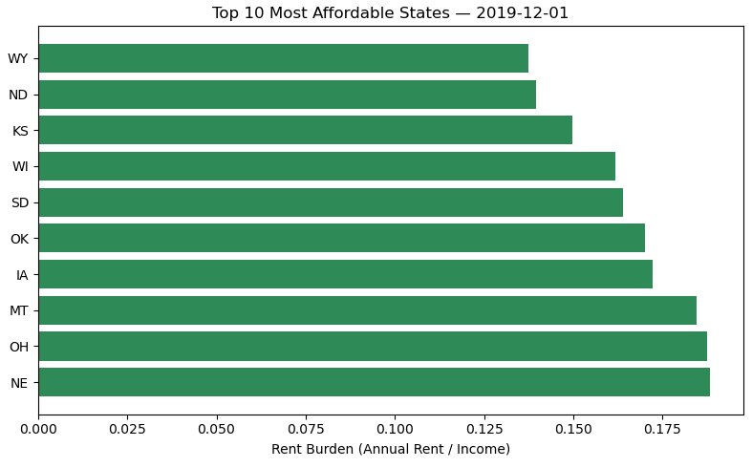
Most Affordable States

Slide 7
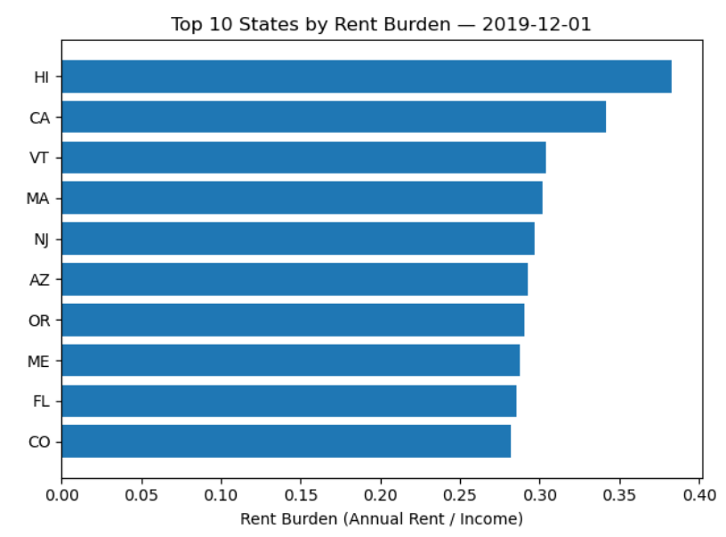
Distribution of Rent Burden

Slide 8
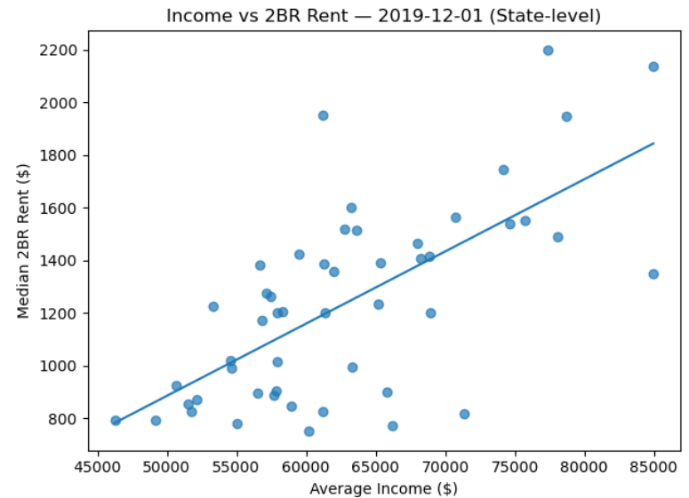
Income vs. Rent Relationship

Slide 9
Interpretation & Discussion
National average: 20% of income spent on rent.
Hawaii nearly 40% rent burden – major outlier.
California, Massachusetts, New Jersey also high burden states.
North Dakota, South Dakota, Nebraska remain affordable at 14–17%.
Income positively associated with rent, but supply & urbanization matter.

Slide 10
Ethical Considerations
Avoid stigmatization of lower-income households or states with affordability issues.
Averages hide local disparities.
Make sure the results are neutral with respect to regional housing challenges.
Affordability is also tied to equity. States with higher populations are affected more.

Slide 11
Limitations & Assumptions
State averages hide within-state variation (urban vs. rural differences).
Assumes rent-to-income ratio is a valid affordability measure.
External shocks (COVID-19, inflation surges) are not fully captured in the datasets.
Assumes income-rent relationships remain stable over time.

Slide 12
Recommendations
Policymakers: Increase the supply of affordable housing, provide rental assistance.
Developers: Identify markets with a high demand for affordable housing.
Financial institutions: Make changes to the lending with affordability in mind.
Future research: include demographics, transportation, and household costs.

Slide 13
Q&A Prep
Q: Why is Hawaii such an outlier?
A: It has limited land and high demand from tourists and residents.
Q: Why did you choose housing affordability as your topic?
A: It is a major issue across America and it causes a strain on many Americans.
Q: Why did you focus your analysis on 2-bedroom data?
A: This data provides a consistent benchmark for family housing needs and is also tracked by Zillow easily.

Slide 14
Thank you
Affordability is uneven across the U.S., worsening in some regions.
Policy and supply-side issues drive disparities more than income alone.
Results from the analysis can guide housing policy, real estate planning, and financial decisions.
Thank you!

Slide 15
Data Sources
Zillow Research: Monthly rental prices at state and city levels.
U.S. Census Bureau (ACS): Household incomes and demographics.
Federal Reserve Economic Data (FRED): Mortgage rates, inflation indicators.
State-level dataset (2022 averages) and city-level dataset (2010–2019).

